Slide 1


Slide 2



Introduction to JSON

Slide 3

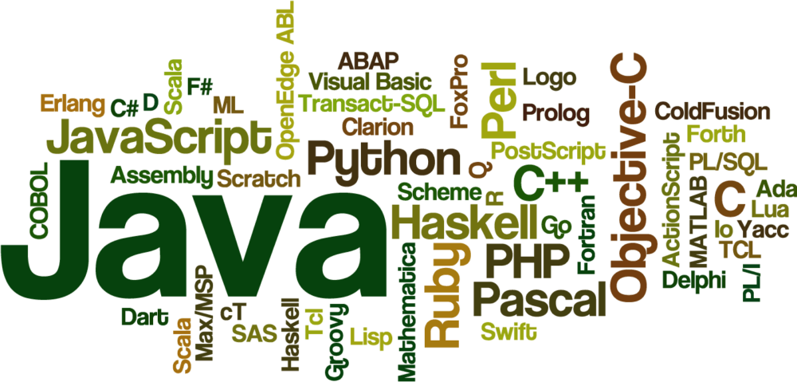


Slide 4
JSON
JSON stands for JavaScript Object Notation.
JSON is an open standard data-interchange format.
JSON is lightweight and self describing.
JSON is originated from JavaScript.
JSON is easy to read and write.
JSON is language independent.
JSON supports data structures such as array and objects

Slide 5
Features of JSON
Simplicity
Openness
Self Describing
Internationalization
Extensibility
Interoperability

Slide 6
JSON vs XML
JSON | XML
JSON is data-oriented. | XML is document-oriented.
JSON doesn't provide display capabilities. | XML provides the capability to display data because it is a markup language.
JSON supports array. | XML doesn't support array
JSON is less secured than XML. | XML is more secured
JSON supports only text and number data type. | XML support many data types such as text, number, images, charts, graphs etc. Moreover, XML offeres options for transferring the format or structure of the data with actual data.

Slide 7
JSON Example
{"employees":[ {"name":"Vimal", "email":"vjaiswal1987@gmail.com"}, {"name":"Rahul", "email":"rahul12@gmail.com"}, {"name":"Jai", "email":"jai87@gmail.com"} ]}

Slide 8
XML EXAMPLE:
<employees> <employee> <name>Vimal</name> <email>vjaiswal1987@gmail.com</email> </employee> <employee> <name>Rahul</name> <email>rahul12@gmail.com</email> </employee> <employee> <name>Jai</name> <email>jai87@gmail.com</email> </employee> </employees>

Slide 9
JSON Example
A JSON object contains data in the form of key/value pair.
The keys are strings and the values are the JSON types.
Keys and values are separated by colon.
Each entry (key/value pair) is separated by comma.
The { (curly brace) represents the JSON object.

Slide 10
EXAMPLE:
{ "employee": { "name": "sonoo", "salary": 56000, "married": true } }

Slide 11
JSON Array example
The [ (square bracket) represents the JSON array.
A JSON array can have values and objects.
Let's see the example of JSON array having values
["Sunday", "Monday", "Tuesday", "Wednesday", "Thursday", "Friday", "Saturday"]

Slide 12
JSON Example 1
{"employees":[ {"name":"Shyam", "email":"shyamjaiswal@gmail.com"}, {"name":"Bob", "email":"bob32@gmail.com"}, {"name":"Jai", "email":"jai87@gmail.com"} ]}

Slide 13
The XML representation of above JSON example is given below.
<employees> <employee> <name>Shyam</name> <email>shyamjaiswal@gmail.com</email> </employee> <employee> <name>Bob</name> <email>bob32@gmail.com</email> </employee> <employee> <name>Jai</name> <email>jai87@gmail.com</email> </employee> </employees>

Slide 14

THANK YOU

